Slide 1
Unveiling Hidden Homelessness across the Island of Ireland – and what it means for Northern Ireland.

Slide 2
welcome

Slide 3
Poll findings:
Karen McAlister, Head of Research & Development, Simon Community

Slide 5
The Journey So Far:
Dr Kevin Cunningham, Ireland Thinks

Slide 6
Under the radar:
Unveiling hidden homelessness across the Island of Ireland
Dr Kevin Cunningham

Slide 7
Hidden Homelessness:

Slide 8
[% Ranked #1]
Hidden homelessness
“People who could be considered homeless but are not visible on the streets or in official statistics, for example, households staying with friends or sharing with family members or squatting”
(Northern Ireland Audit Office)
“People who stay with friends, family, or even strangers. They are typically not paying rent, their duration of stay is unsustainable in the long term, and they do not have the means to secure their own permanent housing in the future. They differ from those who are staying with friends or family out of choice in anticipation of prearranged accommodation, whether in their current hometown or an altogether new community. This living situation is understood by both parties to be temporary, and the assumption is that it will not become permanent” (Gaetz et al., 2012: 4)

Slide 9
[% Ranked #1]
Definitions…
Sometimes sofa surfing used as a synonym for hidden homelessness (Minich et al., 2011; Peters, 2012; Crawley et al., 2013; Findlay et al., 2013; Mayock and Corr, 2013; Elwell-Sutton et al., 2017; Mayock and Parker, 2019)
Sometimes a component of hidden homelessness (Sorensen, 2010; Clarke, 2016; Rodrigue, 2016; Elwell-Sutton et al., 2017; Kauppi et al., 2017; Demaerschalk et al., 2019).
Some employ ETHOS definition (including mobile homes, squat, etc) (European Typology of Homelessness and Housing Exclusion) (Anthopoulou et al., 2019; Mayock and Parker, 2019; Demaerschalk et al., 2019)
Absence in homeless counts – those not regularly making use of services (Sorensen, 2010; Clarke, 2016; Metraux et al., 2016; Mayock and Parker, 2019)
Staying with friends or relatives
‘Sofa surfing’
Living in severely overcrowded conditions
Those involuntarily sharing with other households on a long-term basis
Squatting..
People sleeping rough in hidden locations

Slide 10
Previous research in Ireland
‘Ireland’s Hidden Homelessness Crisis’ by Hearne and & McSweeney (2023)
‘Hidden’ Homelessness in Northern Ireland’ by Gray and Hamilton (2020)
‘The Scale of Hidden Homelessness in Ireland; Understanding Hidden homelessness’ Simon Community (2022)
‘Hidden Homelessness’ Shelter Scotland (2018)
[% Ranked #1]

Slide 11
Two polls:
Republic of Ireland (Ireland Thinks)
Northern Ireland (Lucid Talk)
1,762 (margin of error 2.4%) and
1,050 (margin of error 3.1%)
2nd to 13th March 2024
SMS/Online delivery
Propensity score matching
&
Weighted to be representative Age, Gender, Social Class/ Occupational Grade,
and Region.
[% Ranked #1]

Slide 12
The Results:

Slide 13
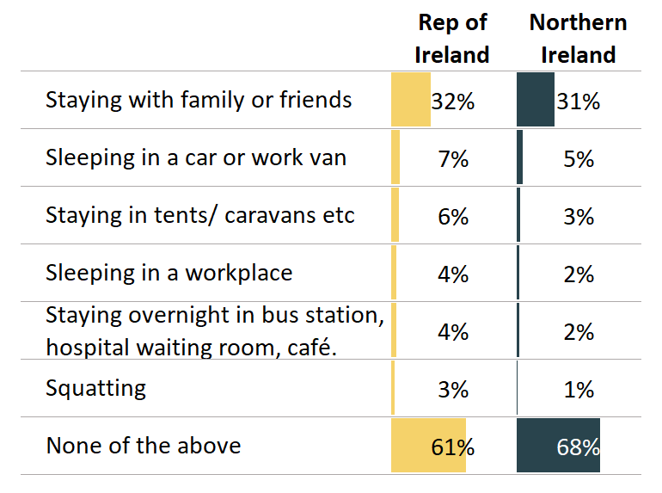
[% Ranked #1]
‘Have you personally, or
do you know of close
family, who have been
forced to stay temporarily in any of the following situations because you/
they do not have a
regular address of
their own?’

Slide 14
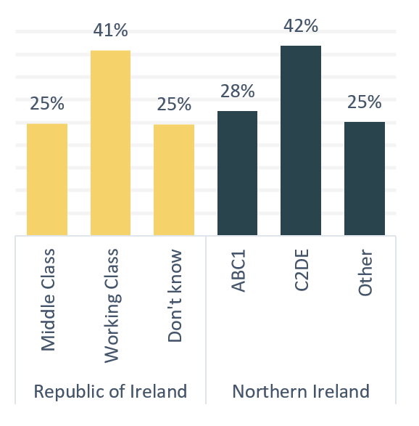
[% Ranked #1]
Social class and known
experiences of staying
with family and friends

Slide 15
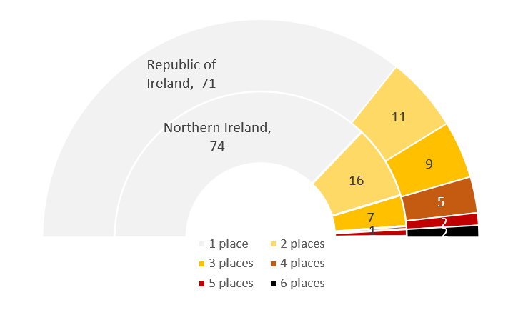
[% Ranked #1]
How many of these situations/places did they select?

Slide 16
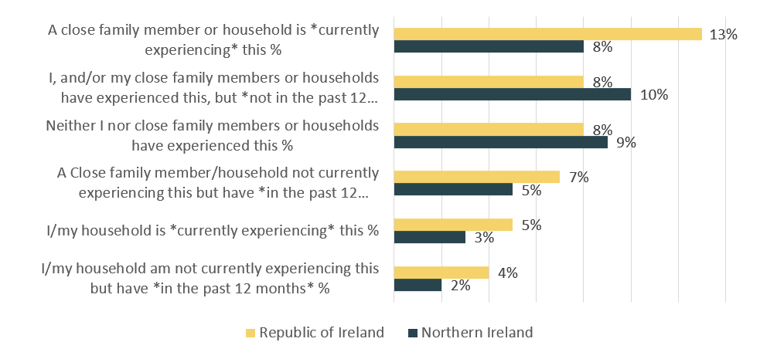
[% Ranked #1]
Thinking about the experience you have identified, which of the following applies or applied:

Slide 17
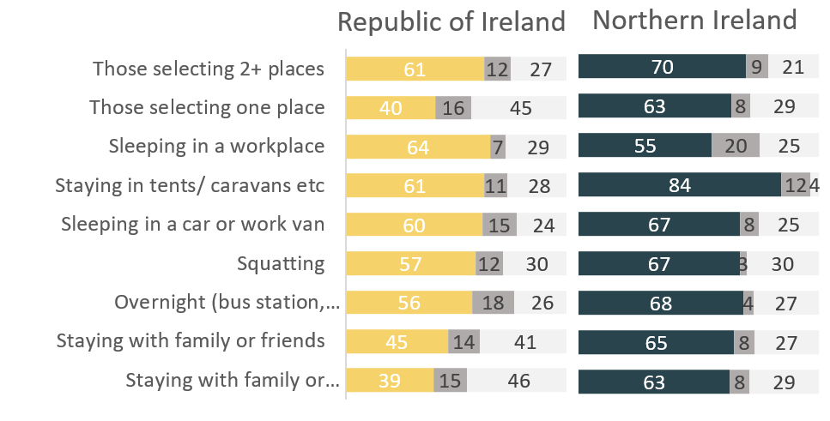
[% Ranked #1]
Places where they record the experience of staying in and whether or
not they contacted their local authority

Slide 18
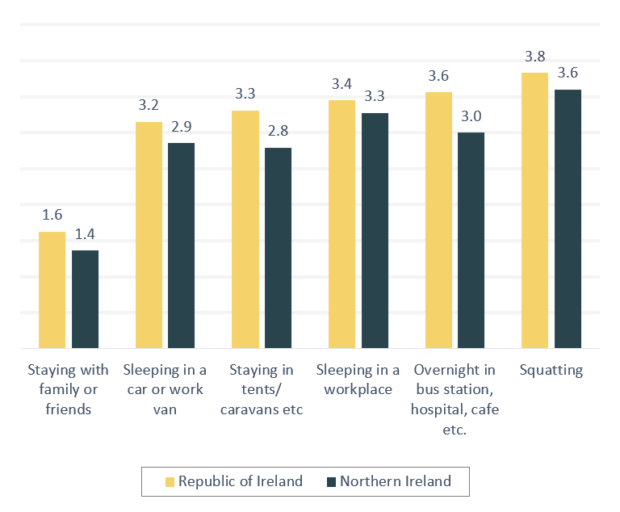
[% Ranked #1]
Average
number of places
selected by place
selected. E.g. on
average, those
that selected
‘staying
overnight..’
selected three
Places that they
had stayed

Slide 19
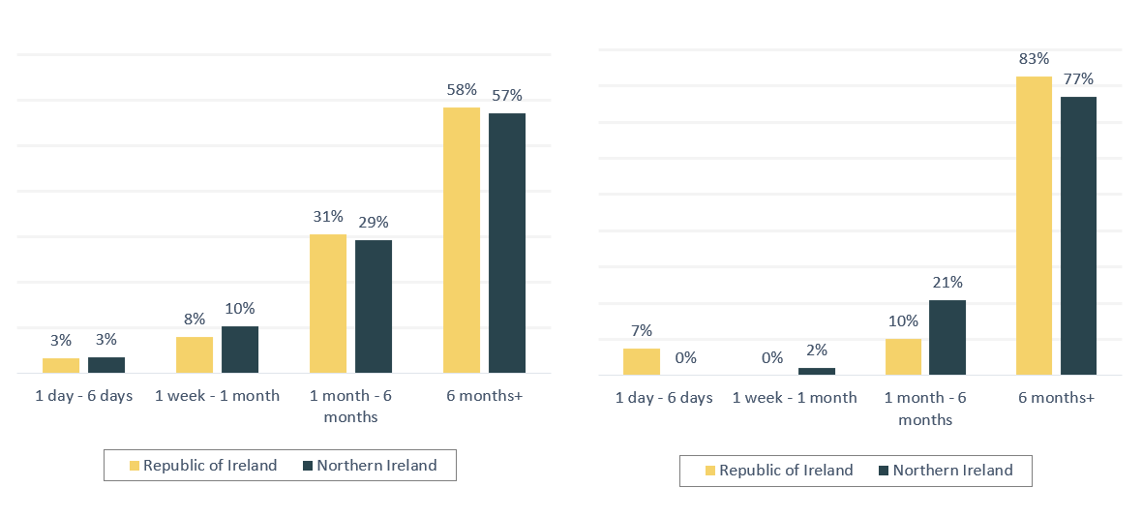
Thinking back to the experiences you indicated in the previous questions how long did has this period last or lasted?
[% Ranked #1]
Those with personal experience
Those with current experience

Slide 20
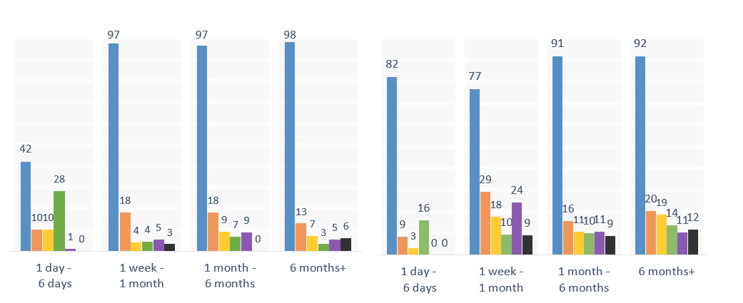
length of time and places stayed
[% Ranked #1]
Northern Ireland
Republic of Ireland

Slide 21
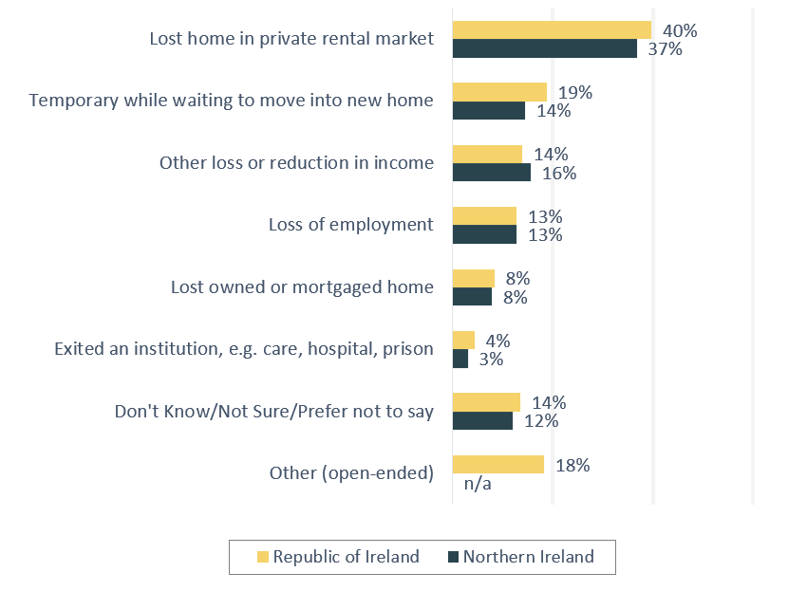
[% Ranked #1]
What was the reason for that situation occurring?

Slide 22
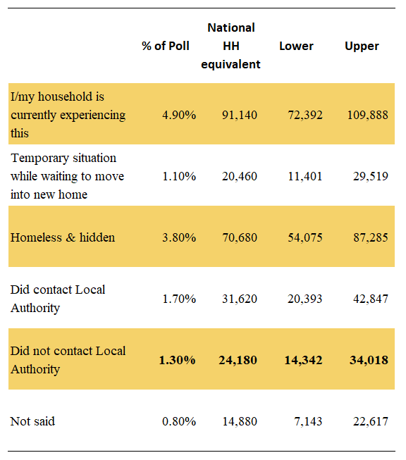
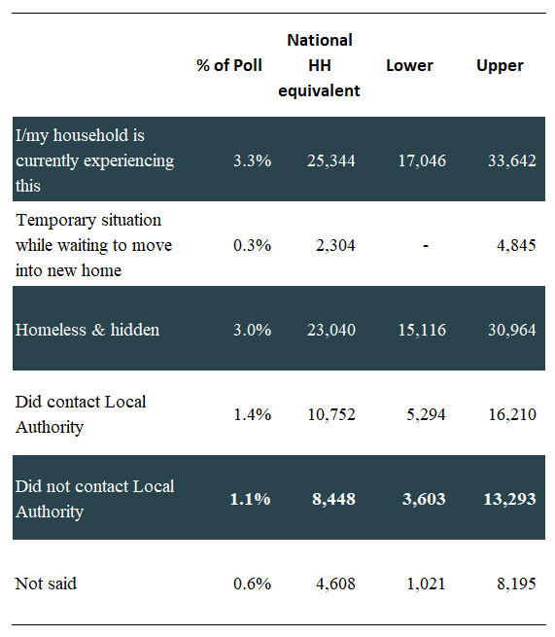
Republic of Ireland
Northern Ireland
[% Ranked #1]

Slide 23
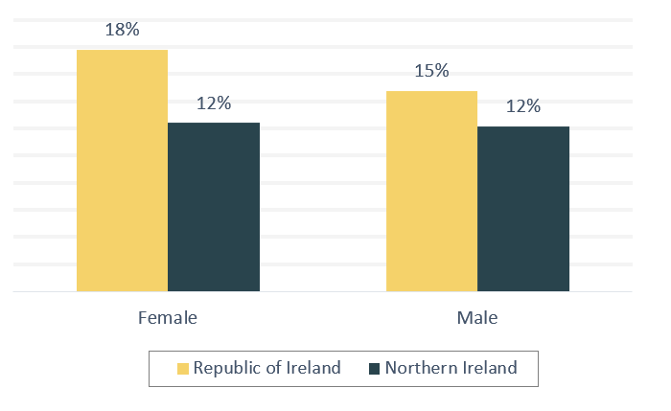
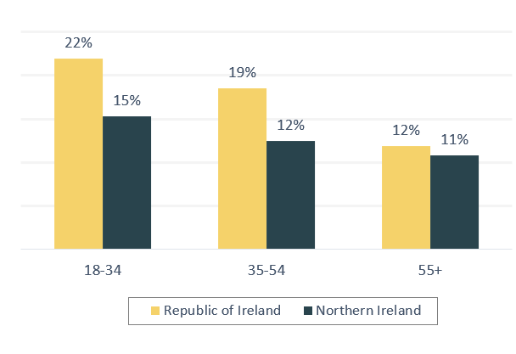
Demography of those experiencing forms of hidden homelessness in their household in the past 12 months
[% Ranked #1]

Slide 24
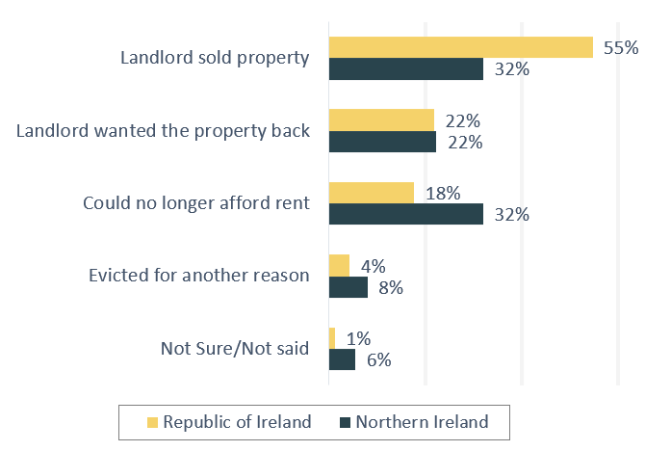
[% Ranked #1]
Selected
reasons given
For the situation
occurring with
regards to former
renters

Slide 25
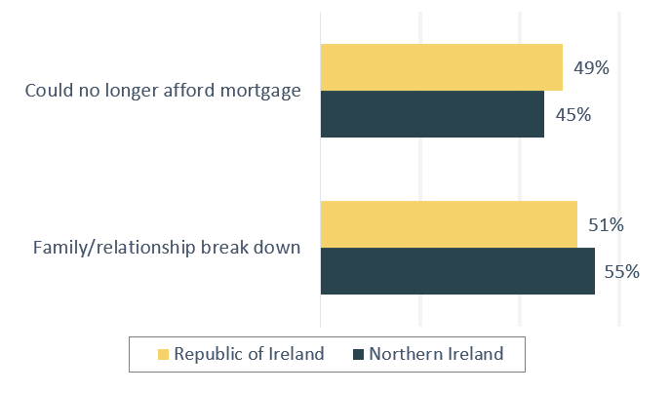
[% Ranked #1]
Selected
reasons given
for the
situation
occurring with
regards to owners
and mortgage
holders

Slide 26
Framing these findings in the context of Northern Ireland:
Professor Ann-Marie Gray, Social Policy, Ulster University

Slide 27
March 2022 – Hidden Homelessness research published
Key challenge – how to measure the hidden homeless population
We identified the contributing factors identified in the research – while these were varied, economic insecurity was a dominant theme
While there were reasons specific to some, overwhelming underlying structural causes

Slide 28
Since then deteriorating economic and political situation
Global economic challenges
Cost of living crisis – but stagnation of income in NI since 2008
Citizens in NI at higher risk of destitution than elsewhere in the UK
Level of financial resilience in NI low
Continuing impact of cumulative welfare reform measure
Pressures across public services increasing housing need and demand
Political instability - and stalling of policy development (between Oct 2018 and Feb 2024 the NIA functioned for 29 out of 63 months)

Slide 29
Poverty and financial hardship – the NI public
2021 the Northern Ireland Life and Times Survey included questions on poverty and financial hardship (published 2022)
Over 25% of respondents said that they would not be able to afford an unexpected bill of £500
Just over 24 per cent of households reported having to turn the heating down or off due to costs.
Less than two percentage points of a difference between the ability of those in paid employment (24.9%) and those not (26.4%) to afford an expense of £500
What is important here is that this is a random, weighted sample – so not focusing specifically on those estimated to be living in poverty

Slide 30
2023 – the NILT survey asked some of the same findings. The data, published in 2024 shows that a higher number were feeling financial pressure.
70% said that in the past year their household income had fallen below prices
The number saying that could not afford an unexpected expense of £500 had increased to 30% (from 25%)

Slide 31
NILT 2023 Findings
Which one of the following statements best describes how well your household has been keeping up with bills and credit commitments in the past year or so, that is, from October 2022 until now?
 | %
Keeping up with all bills - without any difficulties | 34
Keeping up with all bills - but it was a struggle from time to time | 40
Keeping up with all bills - but it was a constant struggle | 19
Not keeping up with all bills - had fallen behind with some of them | 4
Not keeping up with all bills - had fallen behind with many of them | 1
I don't know | 2

Slide 32
Housing: Affordability
May 2024 – ONS Index Private Housing Rental Prices showed that across the UK rents rose by 8.9 % over the previous 12 months
England: 8.9%
Wales: 8.2%
Scotland: 10.0%
NI: 10.4% (to Feb 2024) – for NI this was the highest annual rise since the series commenced in 2016 – lower cost of housing no longer consider a ’protector’ against poverty in NI.
Median rent in NI’s private rented sector accounts for 25% of household income
NI House Rental Index, June –Dec 2023 (Ulster University) - Average rent in NI £849 – ranging from £612 in Fermanagh and Omagh to £949 in Belfast

Slide 33
Housing: Supply
Social Rented Housing Waiting Lists (across all LGDs in NI) = 47,312; number in housing stress = 35,464
Waiting lists increasing – but Right to Buy remains (ended for Housing Associations 2022). Since 1979 120,000 properties sold - decline in homes for rent is unsustainable
Access to PRS – demand, deposits, security
Pressure on home owners with mortgages

Slide 34
Hidden Homeless – need to see policy progress on a number of fronts
Further progress with planned housing policies – and need for radical approach?
Progress on addressing poverty – publication and implementation of anti-poverty strategy, gender equality strategy and disability strategy
Support for CVS organisations - across a range of areas
Social security protections (within powers of devolved government)

Slide 35
How Can Hidden Homelessness Inform Strategic Social Housing Planning Northern Ireland:
Brian O’Kane, Assistant Director, NIHE

Slide 37
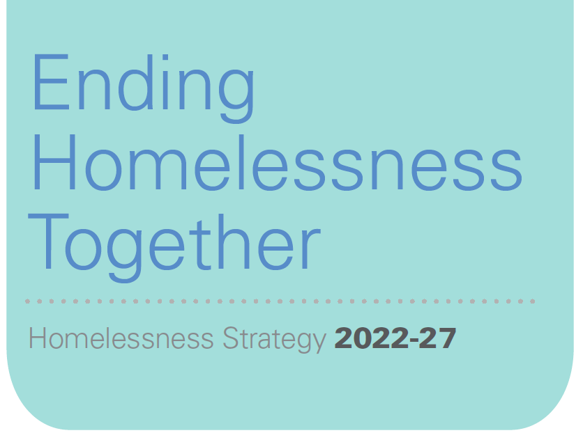
A strategic shift towards homelessness prevention
Brian O’Kane
Assistant Director, NIHE

Slide 38
Hidden Homelessness
Homelessness Strategy notes that it is necessary to ensure that ‘hidden households’ are provided with the means to access the housing and support services they may require
Through the Strategy we seek to ensure that relevant actions are developed around increasing awareness alongside the development of protocols with partners to engage with those who are considered as hidden homeless

Slide 39
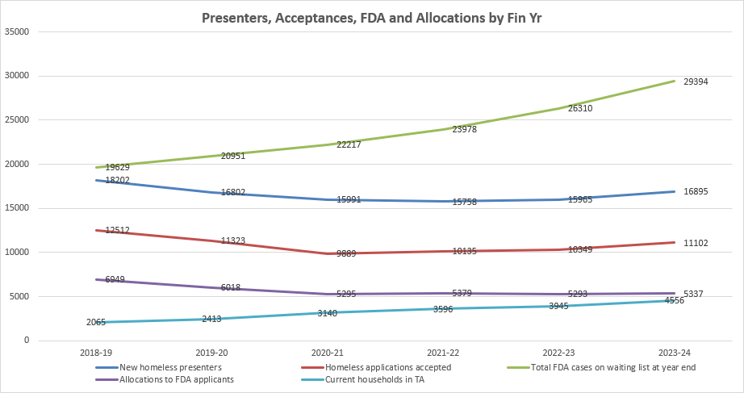

Slide 40
Presenters for reasons linked to affordability
Ppresentation Reason | 2022/23 | 2023/24 | % Difference
ANR: Financial Hardship | 240 | 478 | +99.2%
Loss of Private Rented Accommodation (LOPRA): Property Sale | 1593 | 1434 | -10%
Loss of Private Rented Accommodation (LOPRA): Affordability | 218 | 238 | +9.2%
Mortgage Arrears | 56 | 77 | +37.5%
Total | 2107 | 2227 | +5.7%

Slide 41
Acceptances for reasons linked to affordability
Ppresentation Reason | 2022/23 | 2023/24 | % Difference
ANR: Financial Hardship | 140 | 320 | +128.6%
Loss of Private Rented Accommodation (LOPRA): Property Sale | 1153 | 1047 | -9.2%
Loss of Private Rented Accommodation (LOPRA): Affordability | 85 | 114 | +34.1%
Mortgage Arrears | 26 | 40 | +53.8%
Total | 1404 | 1521 | +8.3%

Slide 42
Strategic Priorities
Maximise use of ‘own front door’ accommodation
Limit the use of hotel and B&B accommodation for families with children – only in exceptional circumstances and short term
Optimise budget for homelessness services – alignment with HB/UC and Supporting People
Identify strategic partnerships locally and nationally
Bring forward new accommodation models

Slide 43
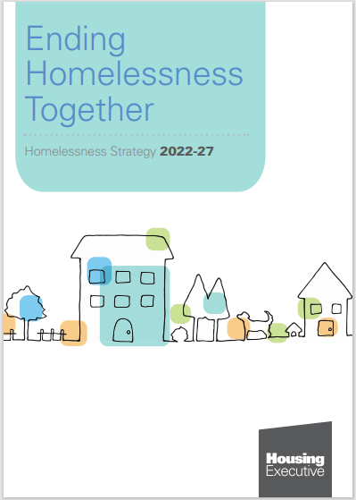
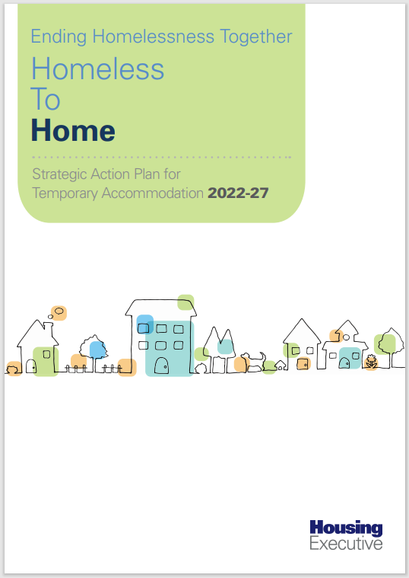
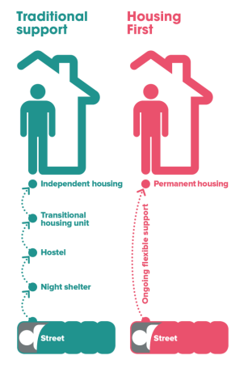
Responding to Homelessness...
Financial Inclusion Managers
Domestic Abuse
Action Plan
Youth Homelessness
Action Plan

Slide 44
Accommodation based response...
Expansion of Shared Tenancies
Development of HMO’s programme
Development of Long Term Leasing Model
Review of the Single Let Model
Increase use of NIHE & HA voids for Temporary Accommodation
Accommodation and support solution for complex cases in West Area
NIHE Acquisitions
Programme of options for Young People leaving care

Slide 45
Questions

Slide 46
What do we do now?
Jim Dennison, CEO, Simon Community

Slide 48
Q
A

Slide 49
thank you
to learn more visit simoncommunity.org
or scan the QR code

